Slide 1
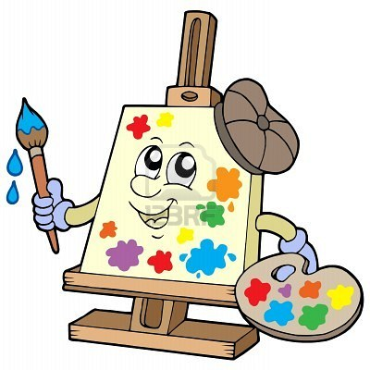
Stage 5: Artist: Functions
http://portafoliodannytop.wikispaces.com/Educaci%C3%B3n+Art%C3%ADstica+I
What do you remember from the last class?
What did you like the best?
Any questions?

Slide 2
Objectives
Students will:
Use a pre-determined function to draw an image with repeated features
Modify an existing function to draw a different shape
Distinguish between functions and loops
Create a program that calls a function from within a loop

Slide 3
Example #1
Help the Zombie Artist draw the outline of the glasses with the given directions.
Put the steps in order in the right sequence.
Notes:
function Draw_lenses() { for (var count = 0; count < 4; count++) { moveForward(100); turnRight(90); } moveForward(100); moveForward(75); for (var count2 = 0; count2 < 4; count2++) { moveForward(100); turnRight(90); } } penColour('#0000cd'); Draw_lenses();

Slide 4
Example ( more challenging)
Use the draw a square function to draw 3 squares. Can you do it with a repeat block?
Notes:
function draw_a_square() { for (var count = 0; count < 4; count++) { moveForward(100); turnRight(90); } } draw_a_square();

Slide 5
Directions
Start on Stage 5: Artist: Functions
Progress through the levels on Stage 5

